Slide 1
INVENTORY MANAGEMENT SYSTEMS
Presented by,
Lisat
Poonam Yadav
Tanuja Lakshmi

Slide 2
CONTENT
What is Inventory management
Two forms of demand
Types of Inventory
Tasks in inventory management
Need of inventory management
Benefits of inventory management
Challenges of inventory management
Scope of inventory management
Objectives of inventory management
Conclusion

Slide 3
Inventory management
Inventory refers to all the items, goods, merchandise, and materials held by a business for selling in the market to earn a profit.
It is the process by which you track your goods throughout your entire supply chain, from purchasing to production to end sales.

Slide 4
Example
If a newspaper vendor uses a vehicle to deliver newspapers to the customers, only the newspaper will be considered inventory. The vehicle will be treated as an asset.

Slide 5
Two Forms of Demand
Dependent
Demand for items used to produce final products
Tires stored at a Goodyear plant are an example of a dependent demand item
Independent
Demand for items used by external customers
Cars, appliances, computers, and houses are examples of independent demand inventory

Slide 6
Types of Inventory Management
Typically, inventory types can be grouped into four categories:
Raw materials
Works-in-progress
Maintenance, repair, and operations (MRO) goods
Finished goods

Slide 7
Raw material
Raw materials consist of all the items that are processed to make the final product. In a cookie manufacturing company, the raw materials are items like milk, sugar, and flour that are used in the different stages of production.
The formula to calculate the total cost of your raw materials inventory is:
Total Raw Materials = Beginning inventory + Purchases added – Ending inventory

Slide 8
Work in progress
When raw materials have been sent for processing but have not yet been approved as finished goods, this stage is known as work in progress.
In a cookie manufacturing company, after the raw materials have been processed and the cookies have been molded, they go for a quality check before they are passed for final packaging.
All the cookies which are waiting for their quality check are considered work in progress. To put it in simple words, the work in progress category consists of all the items that have been processed but not sent for sale.

Slide 9
MRO Goods
MRO inventory management, or maintenance inventory management, is the process of procuring, storing, using, and replenishing the materials and supplies used for maintaining assets at the lowest possible cost.
This process involves ensuring you have stock on hand while factoring in available storage space and budget.
To put it simply, the goal of MRO inventory management is to have the right stock at the right time and place, and at the right cost.

Slide 10
Finished Goods
Finished goods are the final items that are ready for sale in the market. These goods have passed through all stages of production and quality checking. So for the cookie manufacturer, the final packets of cookies that are sent to the market for selling after undergoing quality checks will be the finished goods.

Slide 11
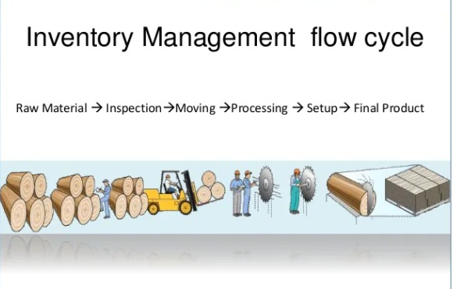
Flow of inventory management

Slide 12
Tasks of Inventory Management
1. Track Inventory:
To look after the amount of inventory that is stock coming into the business.
2. How much to order?
To specify units of inventory to be used by organisation.
3. When to order?
Specify the duration of getting the inventory

Slide 13
Needs of inventory management
It is crucial for an organization today to understand its inventory to achieve both efficient and fast operations, that too, at an affordable cost.
An effective management of inventory helps in reducing costs which further keeps accounts and finances in check.
From a customer’s point of view, it helps you to provide better customer services through fast delivery and low shipping charges, hence, meeting customer expectations.

Slide 14
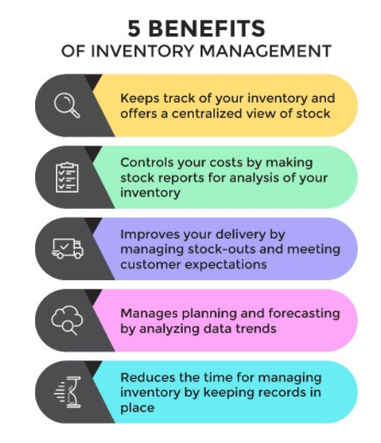
Benefits of inventory management

Slide 15
Challenges of inventory management
Lack of Knowledge: The personnel at the receiving and warehousing departments may lack the required expertise and adequate knowledge of segregating the regular and seasonal goods out of the whole stock.
Expanding Product Portfolios: The customers’ demand and requirements for a wide range of products have tremendously increased the inventory size, making it difficult to manage, manually.
Supply Chain Complexity: The organization, at times, fail to track the stock or goods during the supply chain process. Moreover, it is not necessary that the business partners also maintain an inventory management system, creating hurdles.

Slide 16
Scope of inventory control
SCOPE OF INVENTORY CONTROL
Determination of inventory policies.
Determining economic order size
Determining lead time
Examining the work of inventory policy
Determining various stock levels
Safety or buffer stock

Slide 17
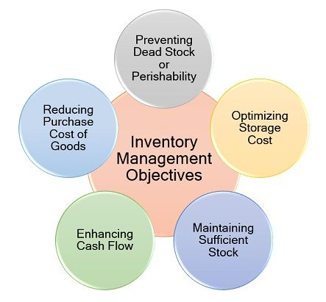
Objectives of inventory control:

Slide 18
Conclusion
Today, inventory management has become vital for the survival of an organization. If you don’t have good control over your inventory, the day is not far when you will lose control of your profits.

Slide 19
Thanks

